Slide 1
Valerie Kean - 309.231.7470
Illinois Sales Executive & Trainer
Valerie@talentassessment.com
www.talentassessment.com
Talent Assessment Inc. has spent over 40 years of hard work publishing and producing Hands-On Assessments and elite programs designed to help both educators and exceptional students achieve their goals.

Slide 2
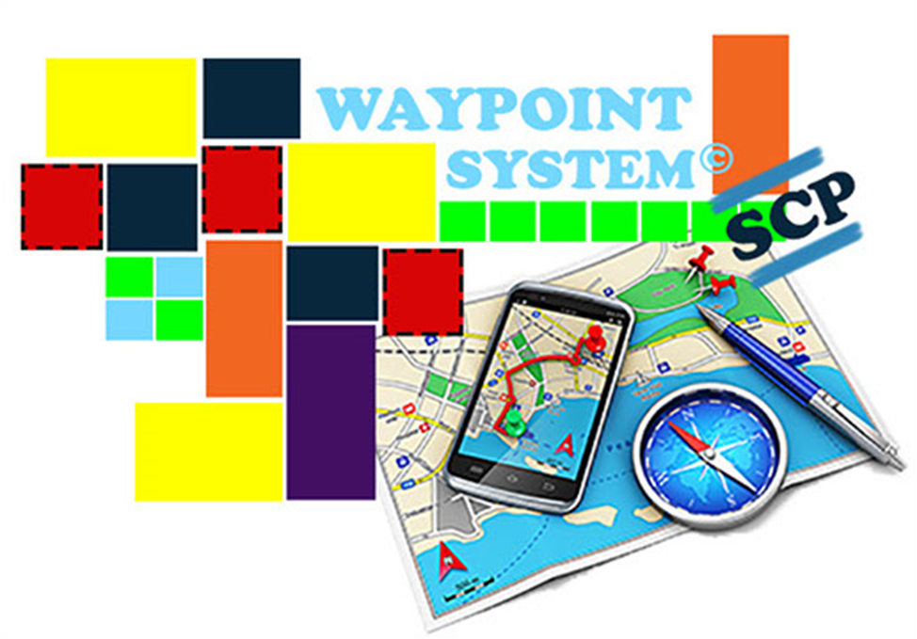
The WayPoint System:
Links students/adults to realistic career & job options both nation wide and in their own communities! Through this assessment driven & personalized transition planning tool we at TAI have closed the gap between transition in education and job placement!

Slide 3
Cloud Based Assessment Driven Transition Planning and Job Placement
Assessment driven career planning & tracking
Helps students develop career goals and transition from school to the post secondary world & the real working world.
Middle Schools, High Schools, Adults
General populations, Individuals with Disabilities, & At Risk Youth
Helps compliance with state and federal transition requirements
WayPoint System SCP

Slide 4
WHAT CAN THEY DO?
WHAT THEY ARE INTERESTED IN?
ARE THEY COMPATABLE WITH? THEIR CHOICES?
WITH TAI’s WAYPOINT ASSESSMENTS YOU WILL FIND OUT…
First… What can they do?

Slide 5
Talent Assessment Program
A Functional Aptitude Assessment System
Assessing the Potential of All Individuals

Slide 6
Form and Spatial Perception
Visual and Color Discrimination
Dexterity and Motor Skills
TAP ASSESSES
THREE MAJOR GROUPS OF FUNCTIONAL APTITUDES

Slide 7
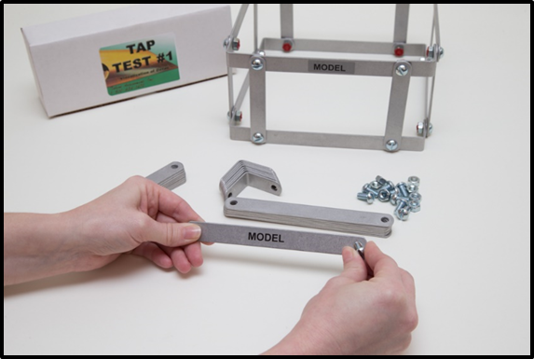
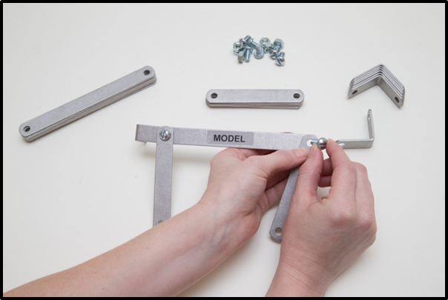
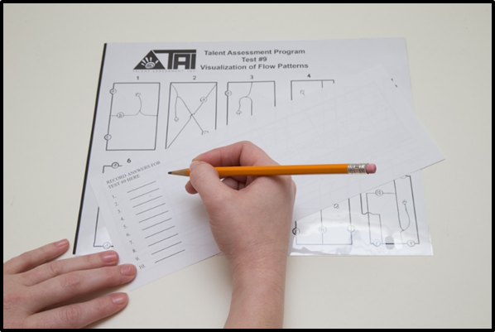
Form And Spatial Perception

Slide 8
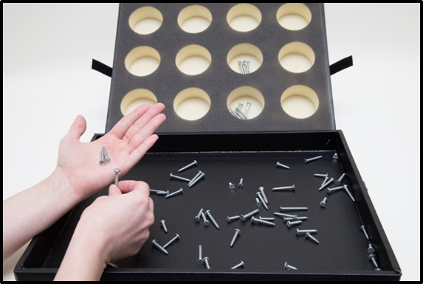
Visual and color discrimination

Slide 9
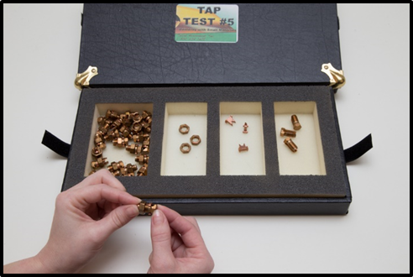
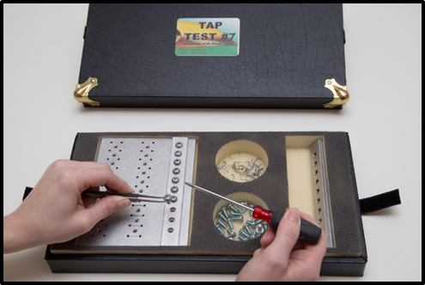
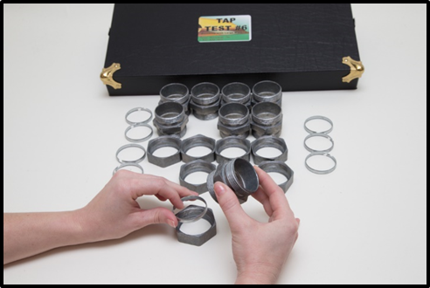
Dexterity and Fine Motor Skills

Slide 10
Next… What are individuals interested in?

Slide 11
PIC allows Students to respond to live action video segments of real work situations.
By rating each segment, students can then determine what Career/Vocational area they like best.
Assessment results are used to pinpoint areas of strong interest, dislikes, and most important, areas which they have little or no knowledge.

Slide 14
And Finally… what are Indivudauls best suited for?
Vocational Implications of Personalities

Slide 15
VIP FUNCTIONS
Works with adults or students regardless of work experience.
Takes less than 20 minutes for 1 or 100 students.
Non-discriminatory.
Identifies every persons unique personality type.
Occupational information is provided based on personality type.
Promotes awareness of interpersonal strengths.
Promotes knowledge of one's working and learning styles.
Works for your low level and non readers.

Slide 16
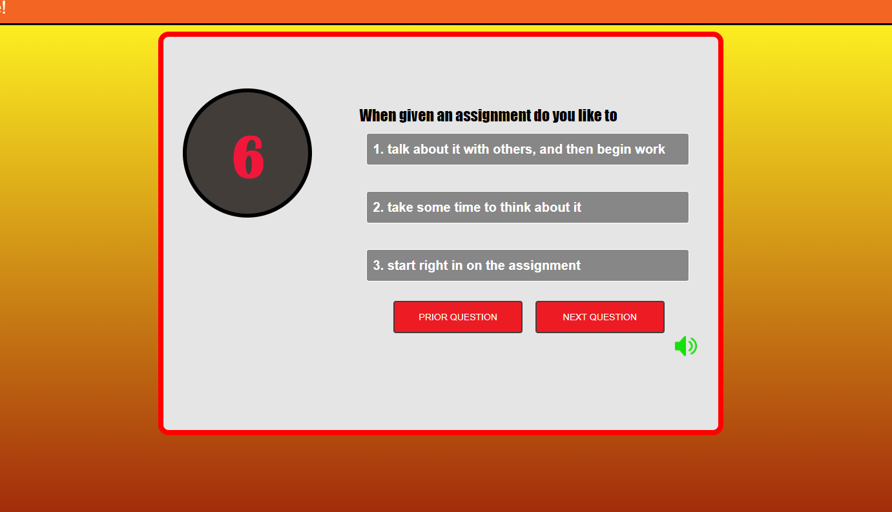
VIP TEST
Audio Option for your low level and non readers.
English and Spanish versions available.

Slide 18
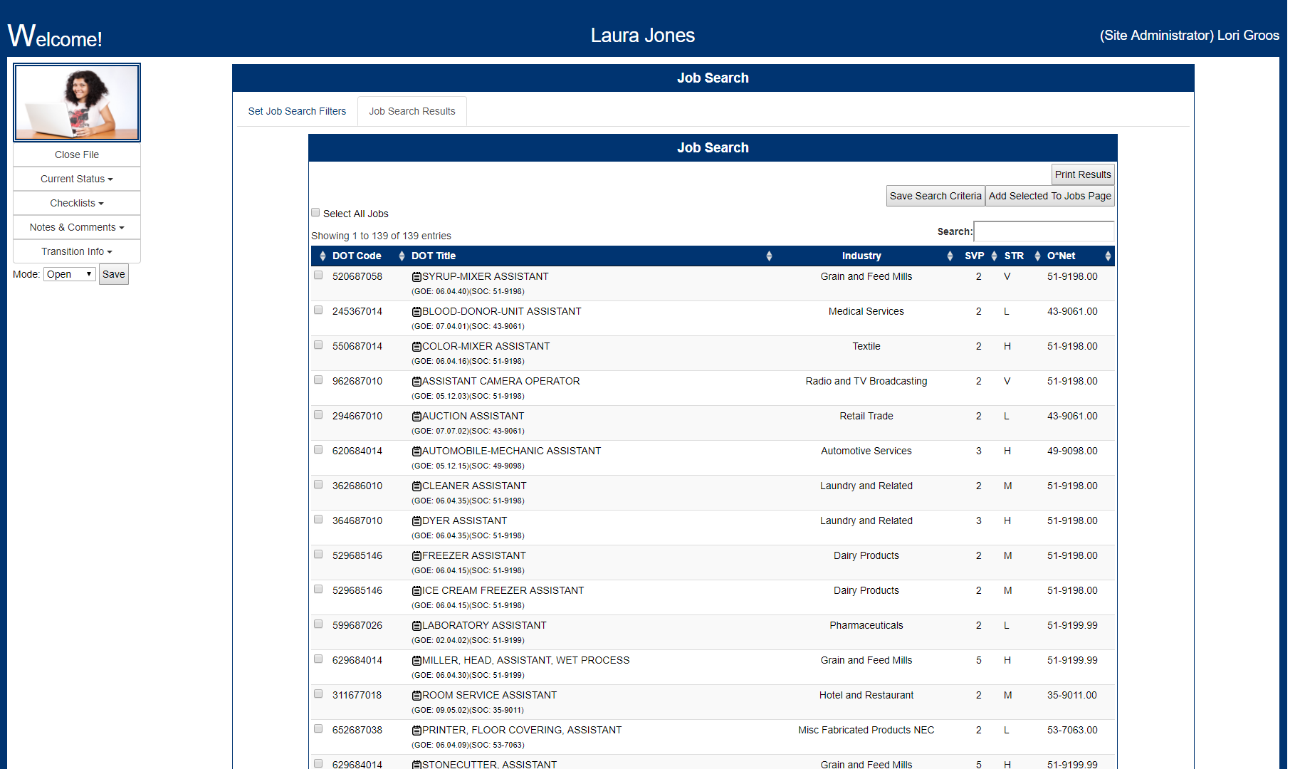

Slide 19
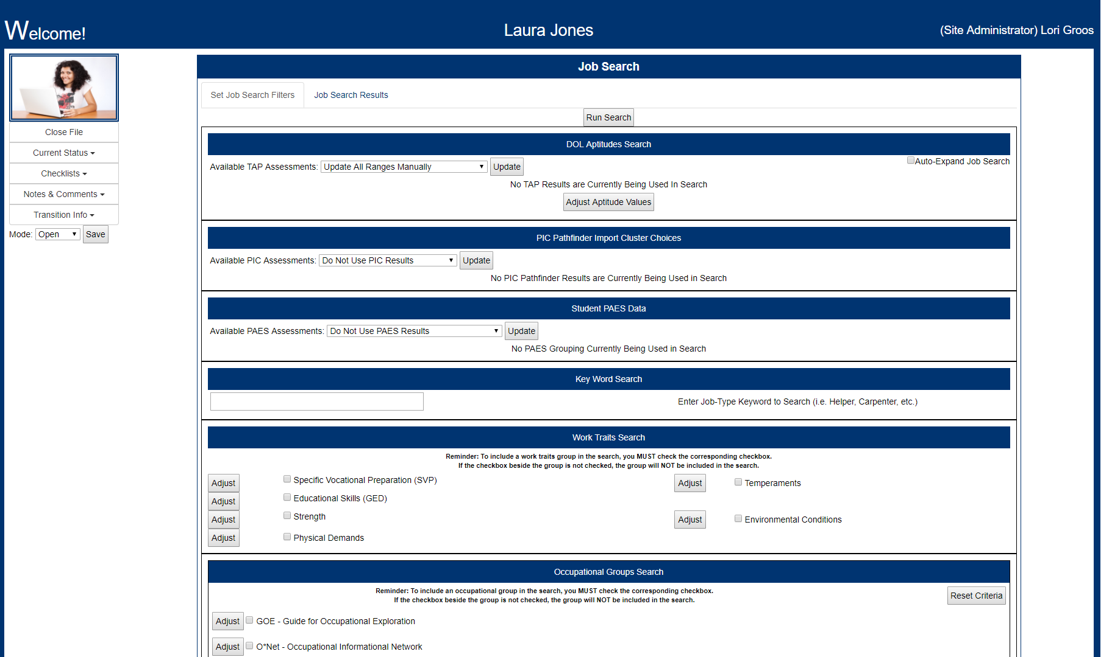
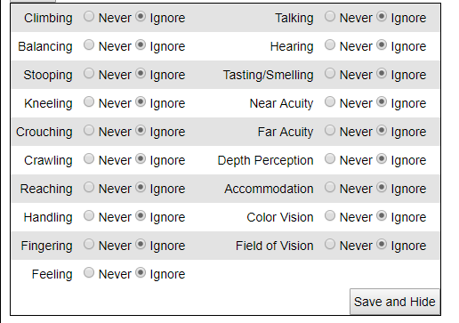

Slide 20
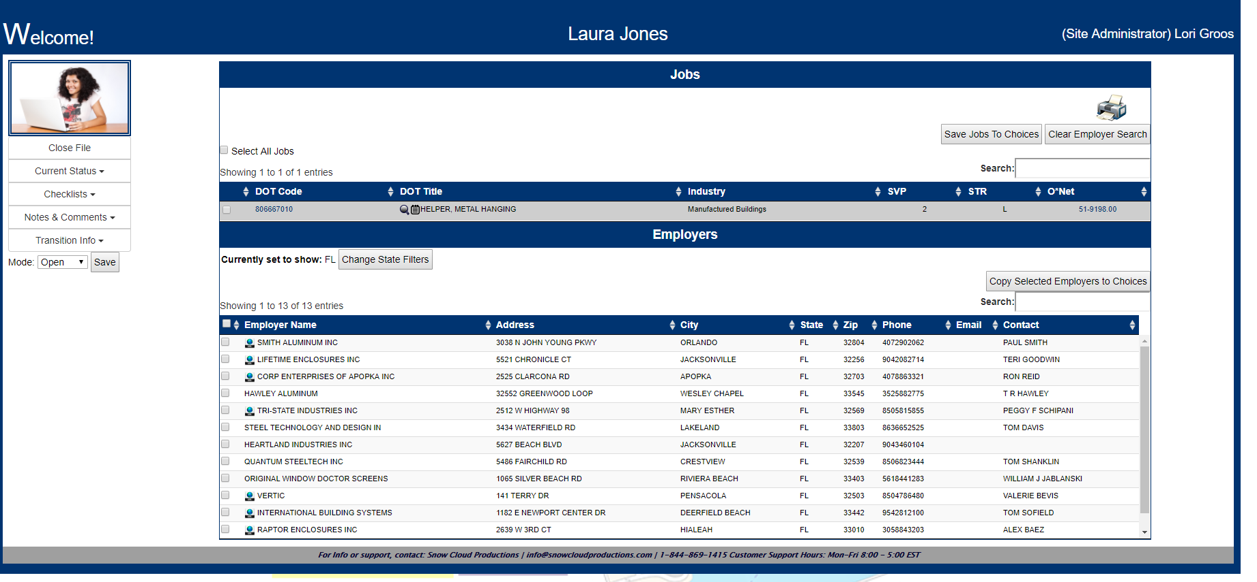

Slide 21
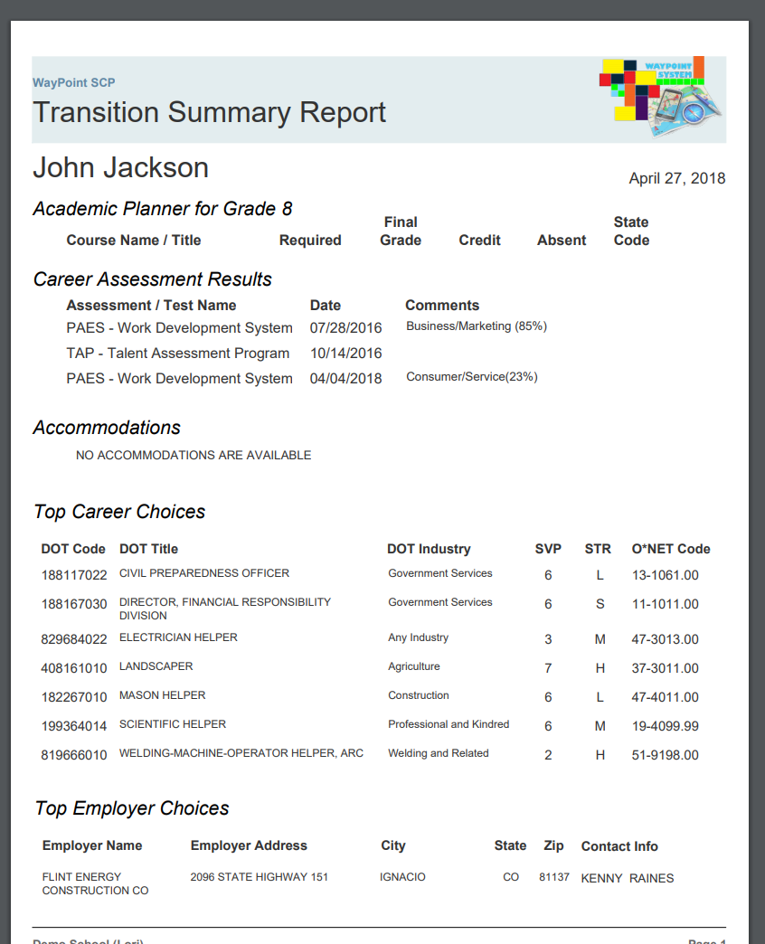

Slide 22
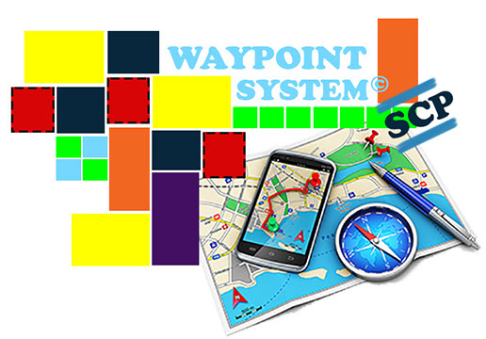
Linking Students to Realistic Career and Job Options in their own Communities!

Slide 23
Practical Assessment Exploration System
Did you know? As of 2018, there are approximately 62 PAES labs in Minnesota, 50 in Illinois, 6 in Missouri, 8 in Wisconsin, 4 in South Dakota & over 1,820 PAES in the U.S.
There are also approximately 10 in Canada, 1 in the Bahamas, and *3 PAES in Europe (England, Germany, and Italy). *purchased by the Department of Defense.

Slide 24
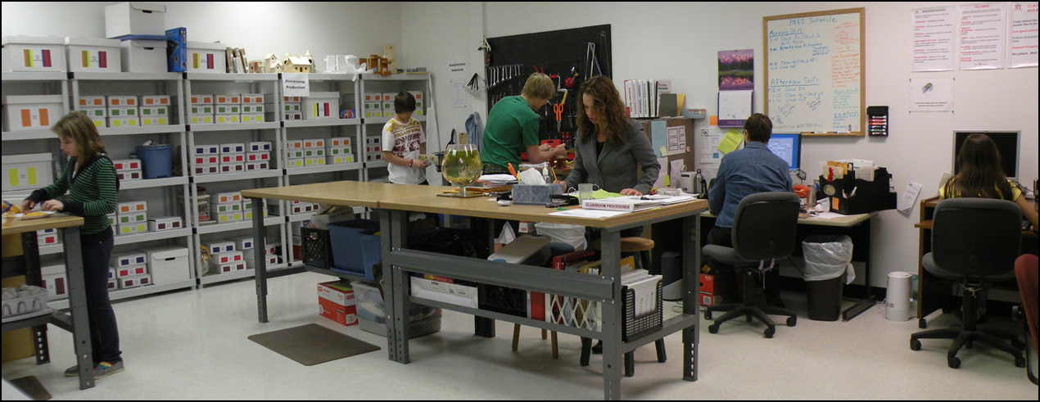
A Research-Based – Age Appropriate Transition Assessment of Employability Skills – Functional Skills – Work Behaviors and Interests
For Middle School, High School, and Special Populations.
Convert typical classroom to a simulated work environment. Teachers become the boss -students become the employees - students punch a time-clock.
Work Development Curriculum

Slide 25
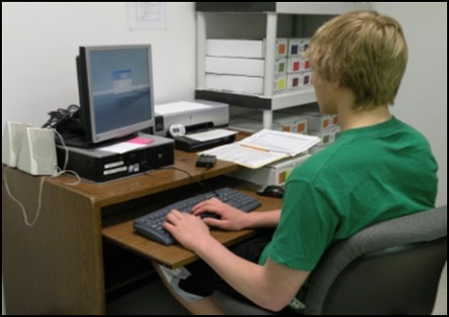
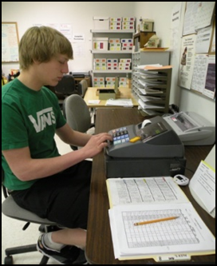
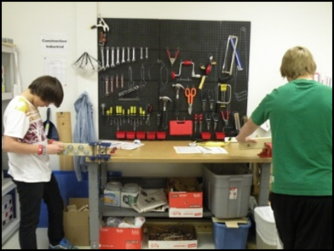
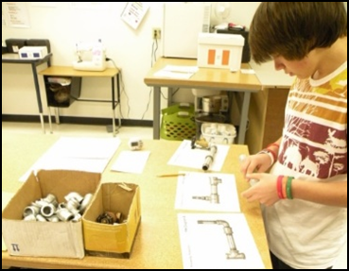
Consumer Services
Computer Technology
Business & Marketing
Construction & Industrial
Processing & Production
Composed of 264 “Hands-on” tasks, giving students the opportunity to solve problems and complete projects that simulate entry level tasks in Five Components.

Slide 26
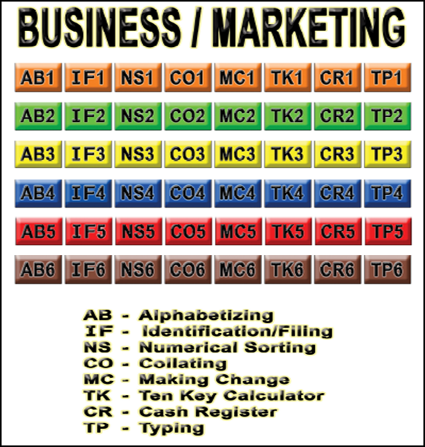
5 Components 8 or 10 Units per Component
Alphabetize 26 cards by 1st letter
Alphabetize 52 cards by 2nd letter
Alphabetize 52 cards by 3rd & 4th letters
Find people in phone book
Find businesses in phone book
Alphabetize 116 cards by last name
Six Jobs per Unit
Alpha Numeric Identification
Jobs are Color Coded from Easiest to Most Difficult
Student Must Attain 100% Mastery before Proceeding to Next Level of Difficulty

Slide 27
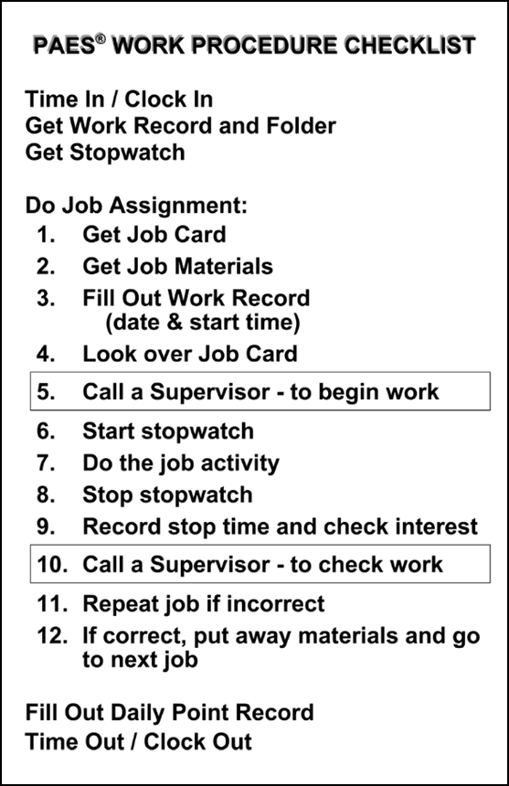
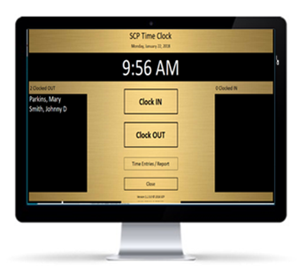
Work Procedures
Students (employees) follow work procedure checklist
Get work folder
Get job card & materials
Get stopwatch
Call supervisor
Go to work
Teachers (supervisors) give only the necessary level of assistance
Students perform tasks in the classroom that simulates actual Work Environment!
Promotes independent work and problem solving skills!

Slide 28
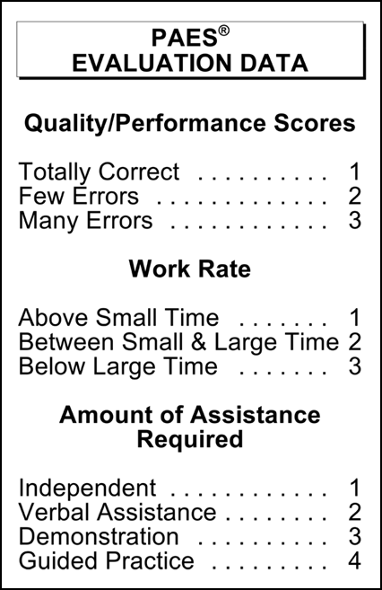
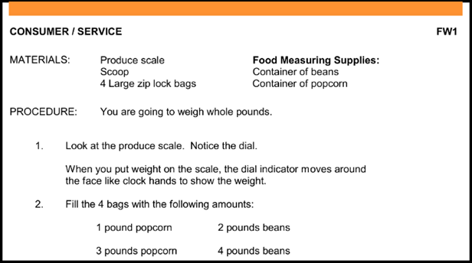
Five Data Points of information are collected.
Students Interest is also recorded
-HIGH, MODERATE, OR LOW-

Slide 29
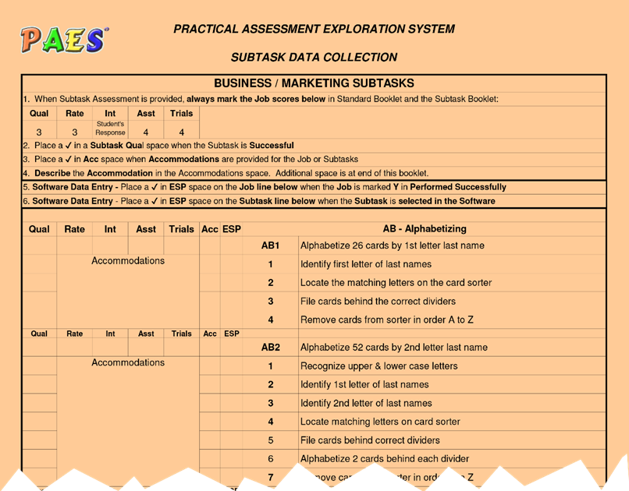
Standard Data Collection
&
Sub-Task Data Collection
Allows Assessment to be taken on any Individuals at Varying Levels of Learning.
Measures level of support required to do the job!

Slide 30
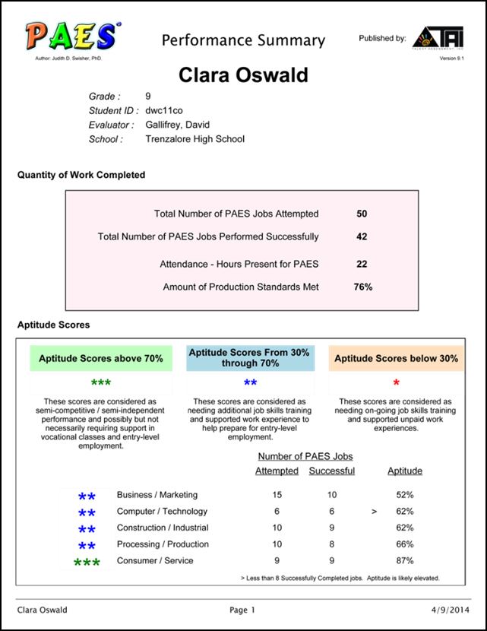
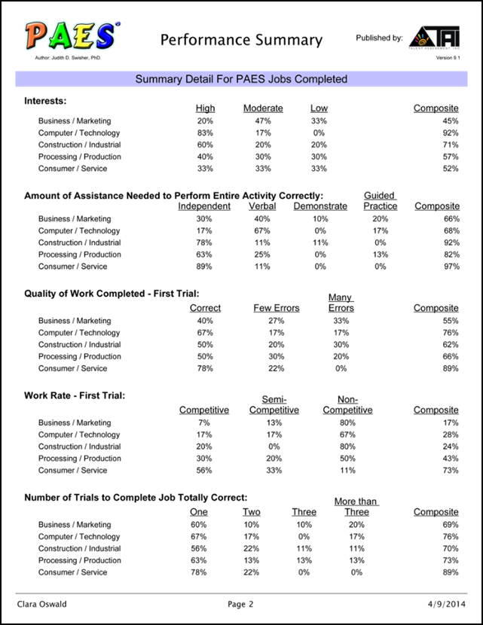
Individual Performance Summary Report
Successful & appropriate work placement
IEPs and Transition Planning
Transition Compliance - State, Federal (IDEA Indicator 13)

Slide 31
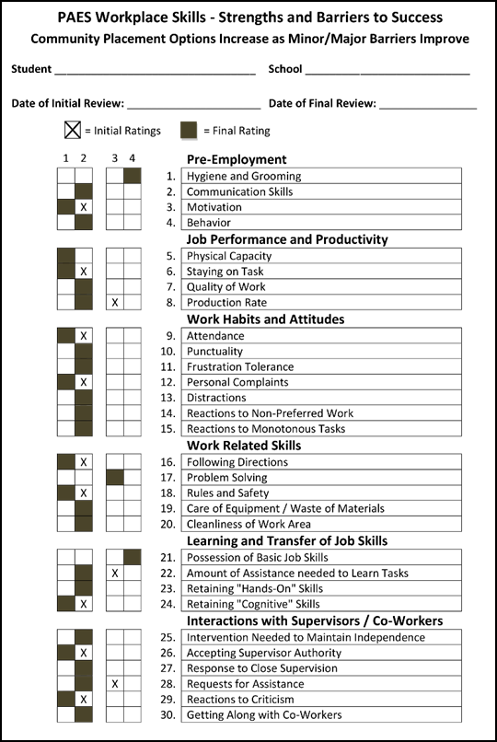
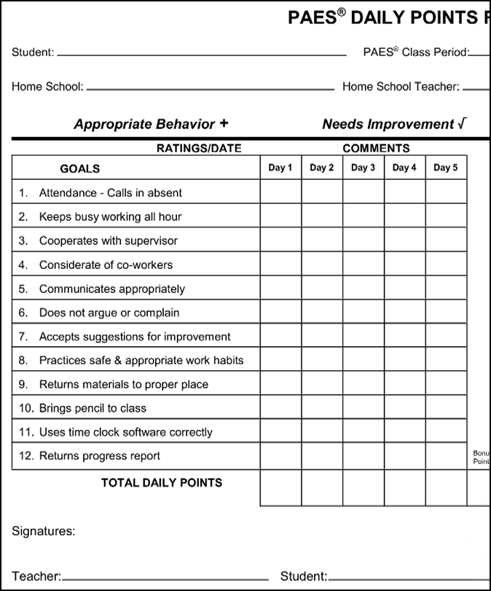
Work Behavior Development & Assessment

Slide 32
In Summary
PAES® is a Hands-On program that “multi-tasks”
Career & life skills training
Performance based assessments
Career exploration
Work behavior development
Data collection
Used towards successful & appropriate work placement
Used for IEPs and transition planning
Helps with Transition Compliance - State, Federal - including IDEA Indicator 13

Slide 33
Upon Completion
The Student/Individual:
Has learned entry-level skills in multiple career/work areas
Has learned how to follow work procedures
Has learned about his/her own appropriate work behaviors
Has discovered his/her interest for certain tasks and job skills
Has learned problem-solving skills
Educators Know:
What skills students can perform competitively
What special assistance or adaptations are required for some students
The best next step for each student
The job strengths and preferences of the student
The level of appropriate work behaviors
Vital transition information for IEPs and appropriate job placement

Slide 34
http://www.wbay.com/content/news/Manawa-paving-the-way-for-special-education-students--479573423.html
For Information Contact:
Valerie Kean
Illinois Sales Executive & Certified Trainer
309.231.7470

